Slide 1
Welcome to DevOpsDC!
6:30 - 7:00: Meet, greet, and eat!
7:00 - 7:15: Intros and Announcements
7:15 - 8:45: Presentations
Analytics for DevOps – Badri Sriraman
State of the Software Supply Chain – Derek Weeks
Applying DevOps to Deliver Quality at Speed – Barry Snyder
8:45 - 9:00: Networking

Slide 2



Sponsors
Notes:
Optoro – location
Fugue – Food
Riverbed - drinks

Slide 3
Code of Conduct
http://www.meetup.com/DevOpsDC/pages/Code_of_Conduct/
We value the participation of each member of the community and want all attendees to have an enjoyable and fulfilling experience. Accordingly, all attendees are expected to show respect and courtesy to other attendees throughout all Meetup events.
To make clear what is expected, all delegates/attendees, speakers, exhibitors, organizers, and volunteers at any DevOpsDC event are required to conform to our Code of Conduct. Organizers will enforce this code throughout events.
Notes:
Conduct matters, so I’ll give you short, short version:
harassment-free experience for everyone, regardless of who you are
professional audience including people of many different backgrounds
Be kind to others. No smack talk

Slide 4
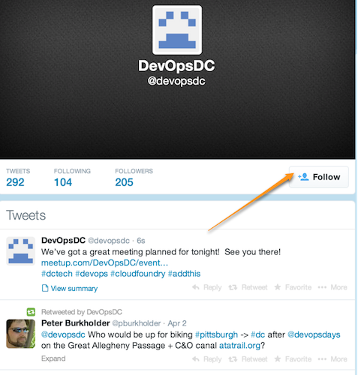
Do you even tweet?
https://twitter.com/devopsdc
Notes:
Twitter properly used is a boon

Slide 5

Slackin'…
http://www.dctechslack.com
Notes:
Now let’s talk about some upcoming events….

Slide 6
Childcare
Contact Peter….
Notes:
Now let’s talk about some upcoming events….

Slide 7

Notes:
http://www.susecon.com/

Slide 8

DevOpsDays Baltimore
March 7 & 8, 2017
http://www.devopsdays.org/events/2017-baltimore/welcome/

Slide 9
More Conferences
DevOpsDays Philly – 26-27 Oct
Container Days NYC – 3-4 Nov

Slide 10
Upcoming Meetups
November 15 –
Location: Excella Consulting
DevOps & Government Contracts
DevOps Improv
December 13 - Excella Consulting, Mark Cornick & Valiant Solutions
Notes:
We moved the November meeting from the 8th to the 15th because of election day.

Slide 11
Now it's your turn…
Hiring?
Looking for work?
Attending or speaking at a conference?
Something we all should know?
Favorite color?
Notes:
DoL Wage & Hour division: Senior Transformation Specialist, Product Manager, Software Engineer, and User Experience Designer
Last year, we put more than $246 million into the pockets of more than 240,000 workers who had been deprived of their hard-earned wages.
‣ For German Gomez, it meant finally being able to start a family after he received more than $42,000 in unpaid wages and damages following an investigation that disclosed he had been working 72 hours a week
‣ For Raquel Bruno, it meant being able to finish her degree and help her kids go to school,after the restaurant she worked for was found to owe more than $1 million to its workers.

